Slide 1

Multi-Node ROS Application for Robotic Platform
Developed by
Pooya Nasiri and Arash A. Malekshah

Slide 2
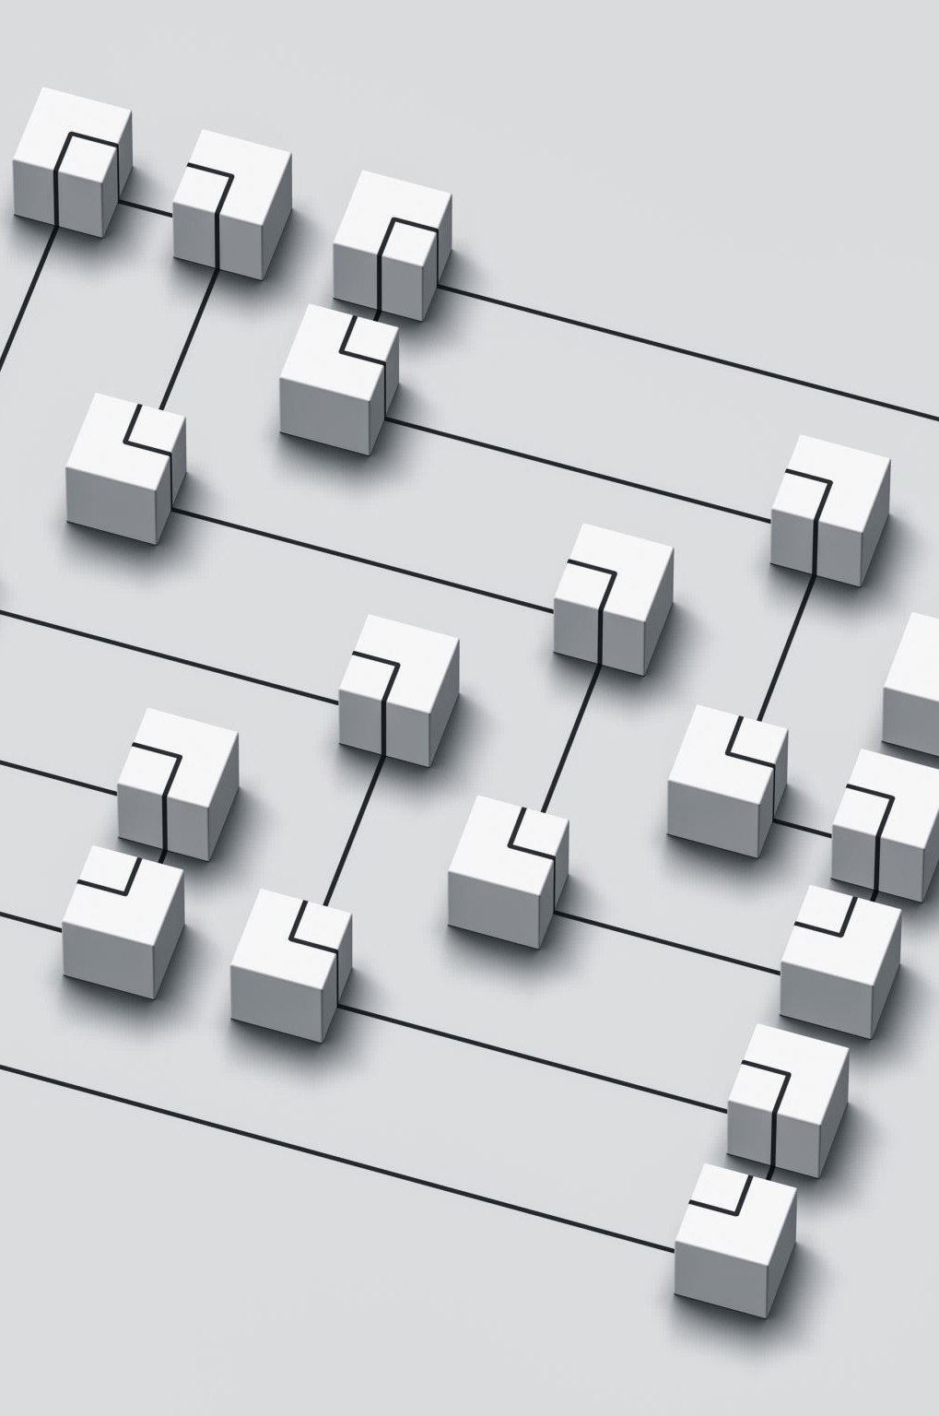
Project Overview
In this project, we focused on three main tasks: navigation, object detection, and manipulation. We developed a modular system with distinct nodes for each task, ensuring seamless communication via ROS.

Slide 3

Project Objectives
The primary objectives of this project were to develop robust navigation, object detection, and manipulation systems for a robotic platform. We aimed to ensure stable communication between nodes and efficient task execution.

Slide 4

System Architecture
Our system is designed with a modular architecture, which enhances code clarity and maintainability. Each node performs distinct tasks, which we will see in detail.

Slide 5

Three nodes
Node A: Responsible for navigation and obstacle avoidance.
Node B: Focuses on object detection using AprilTags.
Node C: Handles object manipulation and placement.

Slide 6

System Architecture
Human_node.cpp
srv
msg
msg
nodeA.cpp
nodeB.cpp
nodeC.cpp
action
action
action
MyActionServer.cpp

Slide 7

Node A - Navigation and Obstacle Avoidance
Node A, implemented in nodeA.cpp, is responsible for guiding the robot to specific poses and avoiding obstacles. This node includes a custom ServiceClient for dynamic obstacle detection and uses MoveIt! to adjust the robot's torso height for optimal object detection.

Slide 8

Node A Implementation Details
Key implementation steps for Node A include setting up the service client, managing navigation goals, handling obstacle avoidance, adjusting the robot's torso and head positions, and coordinating with Node B.

Slide 9
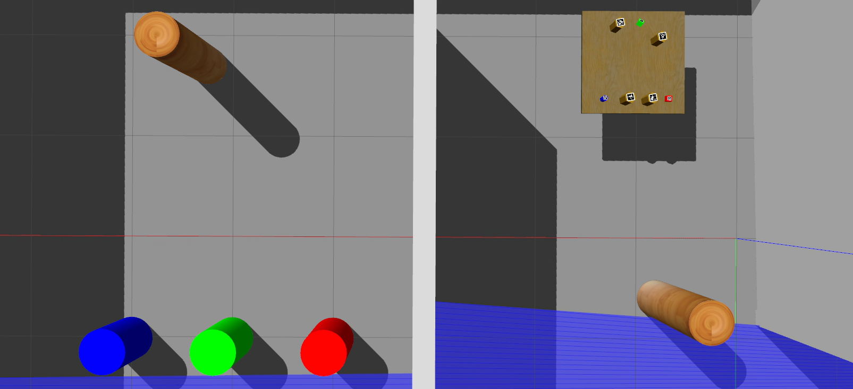
Node A - Navigation Overview
Node A's primary objective is to guide the robot to a designated pose using custom services and action clients for navigation and obstacle avoidance.

Slide 10
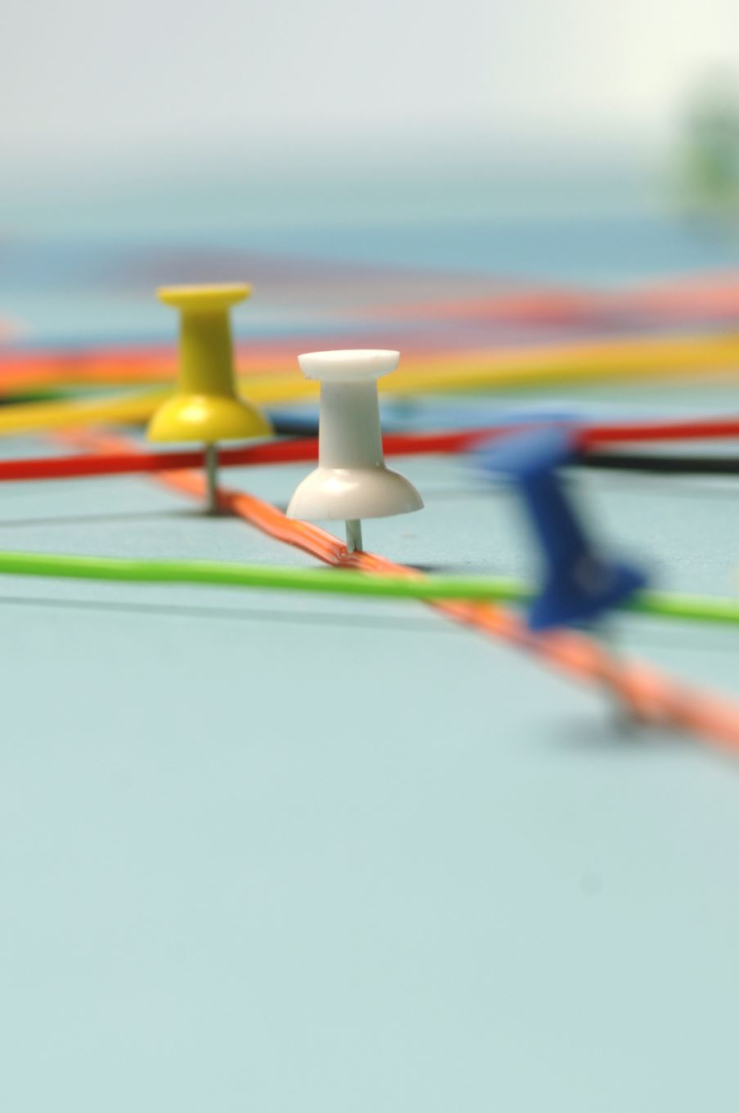
Obstacle Detection and Navigation
Node A includes a ServiceClient for obstacle detection, which manages dynamic obstacles during navigation. Challenges such as navigating around cylindrical obstacles are addressed using partial pose adjustments.

Slide 11
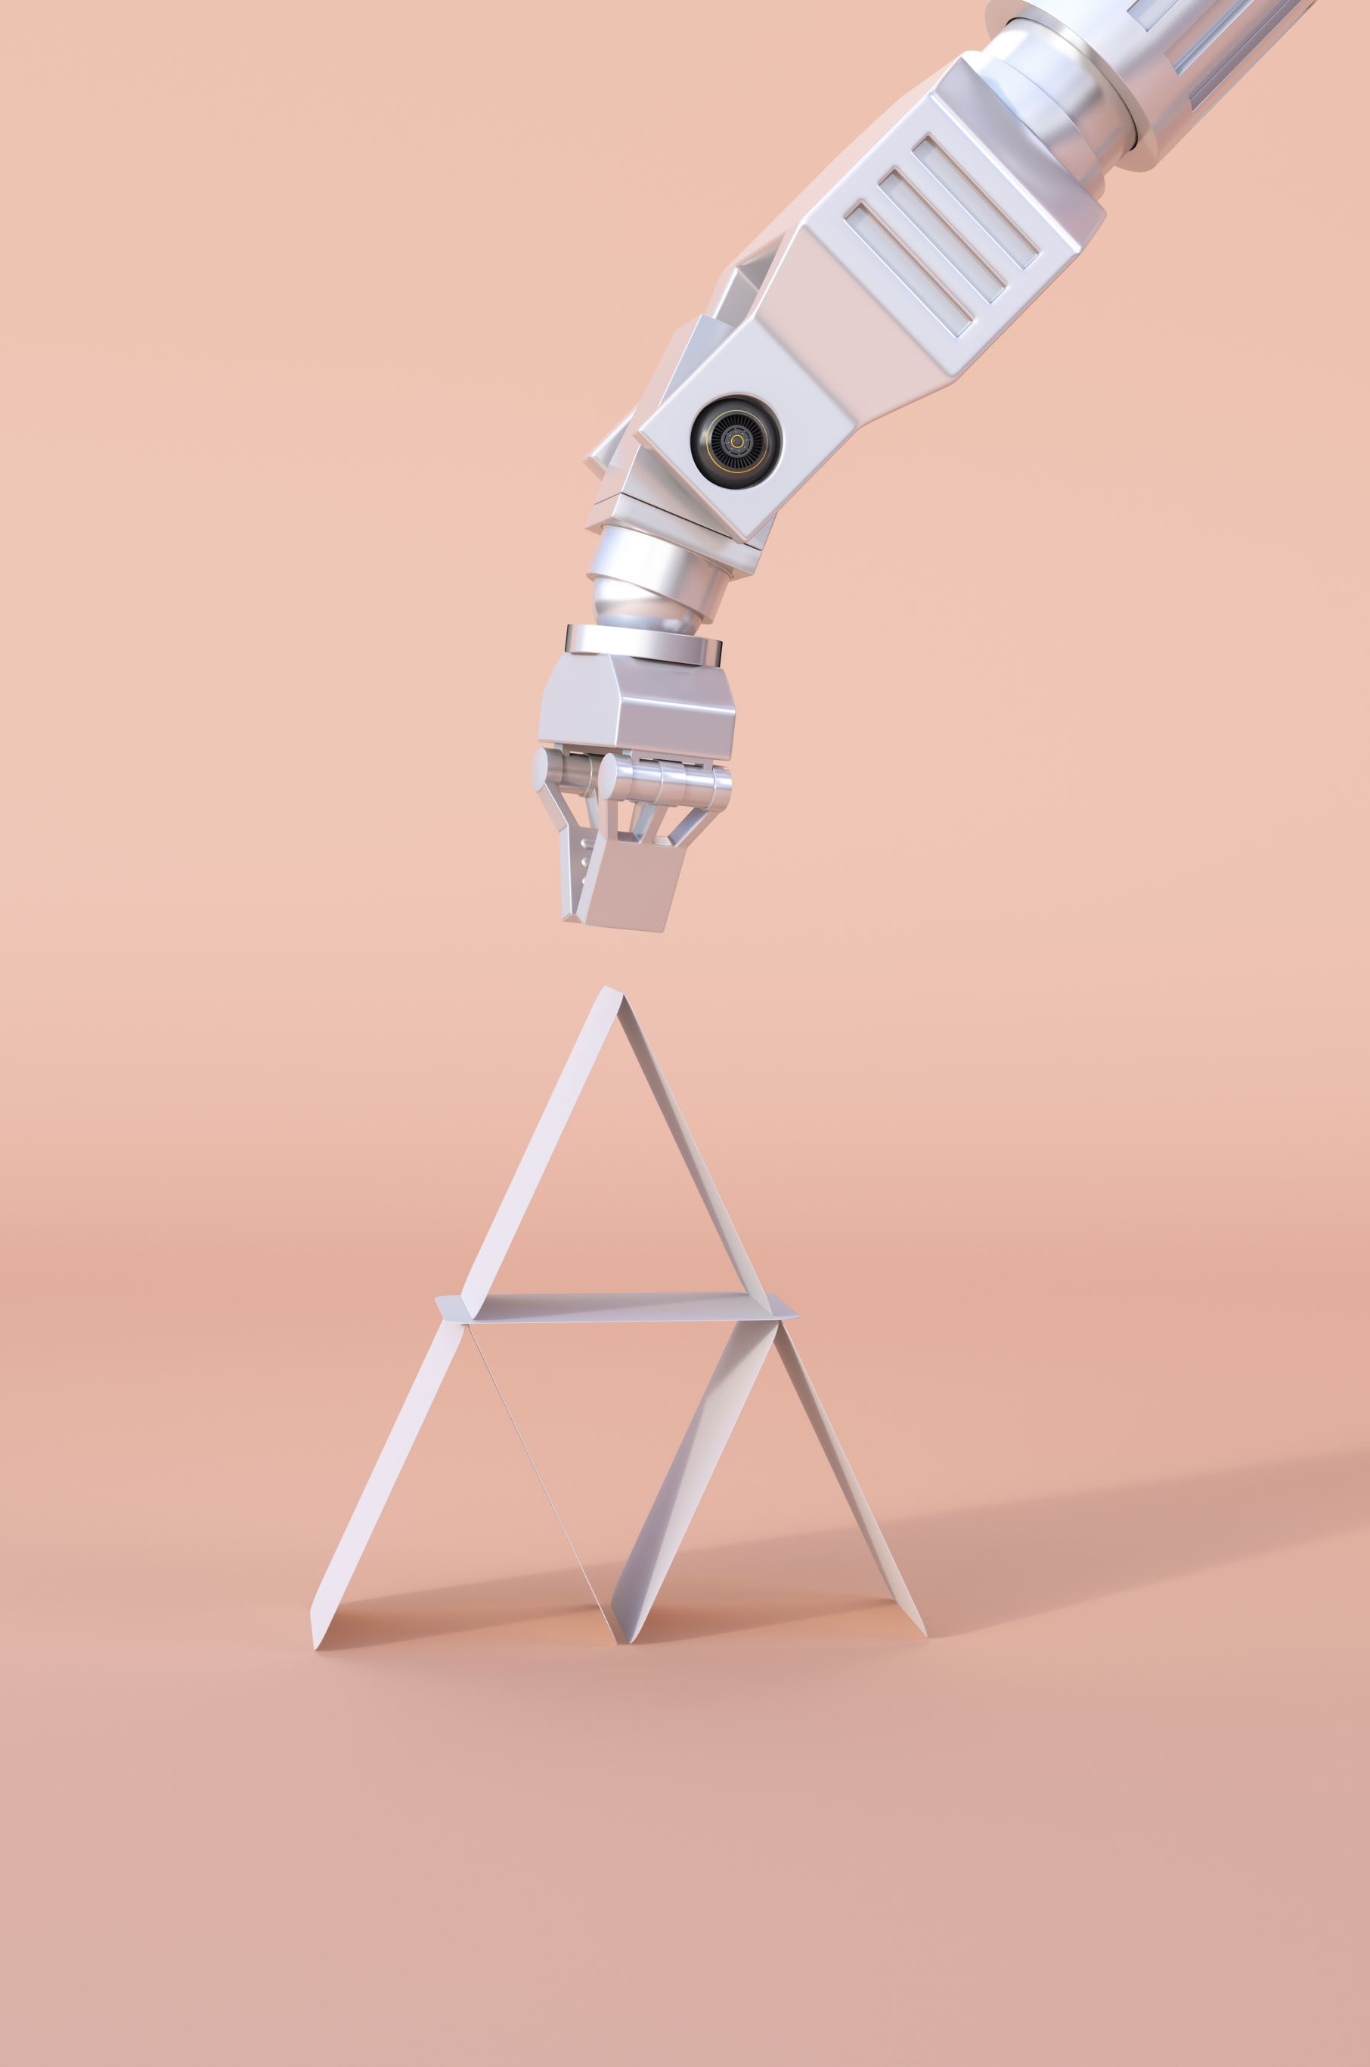
Adjusting Torso Height with MoveIt!
The node optimizes object detection by adjusting the robot’s torso height using MoveIt!. This ensures the camera has the best possible view of the objects.

Slide 12

Head Movement and ROS Communication
A HeadMover class is used to manipulate the robot’s head position, enhancing object detection accuracy. Several ROS publishers and message handlers coordinate the detection process.

Slide 13

Completion Signal to Node B
After completing its tasks, Node A sends a signal to Node B to commence its operations, ensuring synchronized task execution.

Slide 14
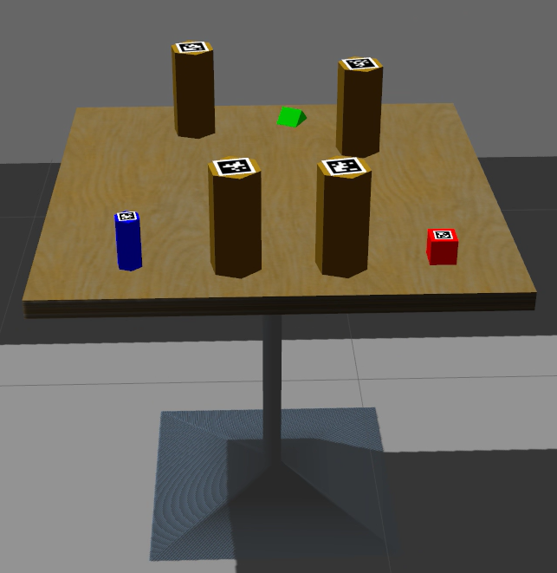
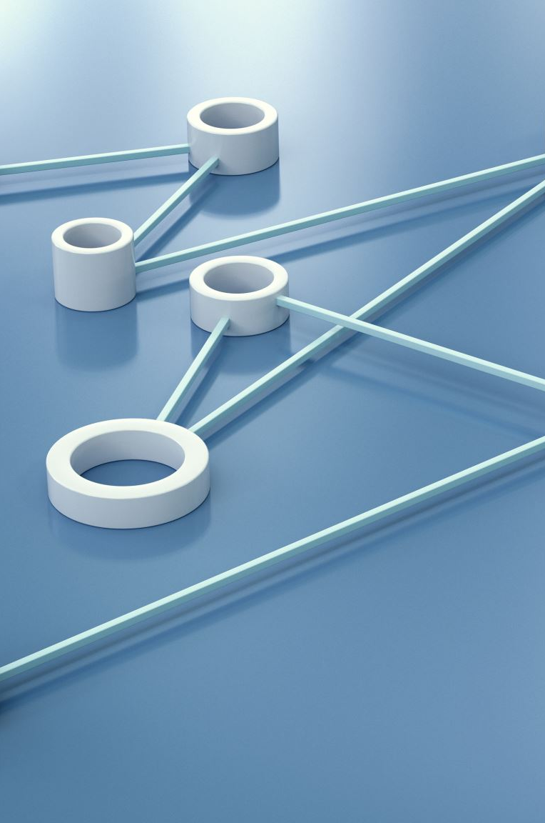
Node B - Object Detection
Node B is responsible for identifying and localizing objects using AprilTag detections. This node processes visual information from the robot’s camera and communicates the results to Node C for manipulation tasks.

Slide 15

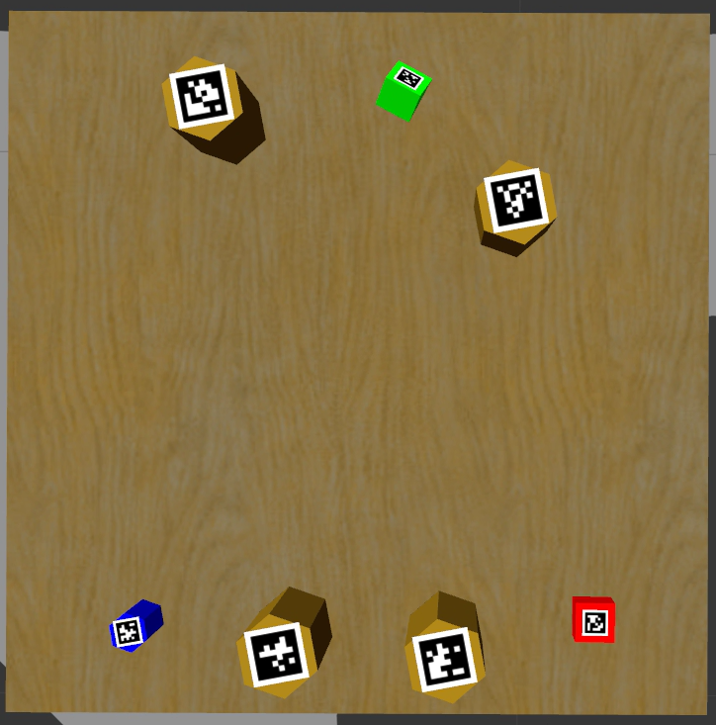
AprilTag Detection and Callback
Node B subscribes to tag detections to receive AprilTag detections, ensuring robust object identification and localization. The tagCallback function transforms detected poses into the global map frame, accurately mapping object positions.

Slide 16

Coordination and Multi-View Detection
Node B waits for a signal from Node A to begin detection, ensuring the robot is properly positioned. It employs a multi-view strategy to ensure comprehensive object detection across different viewpoints.

Slide 17

Data Preparation for Node C
Finalized object information is encapsulated in pick_info messages for Node C, facilitating precise object manipulation tasks.

Slide 18
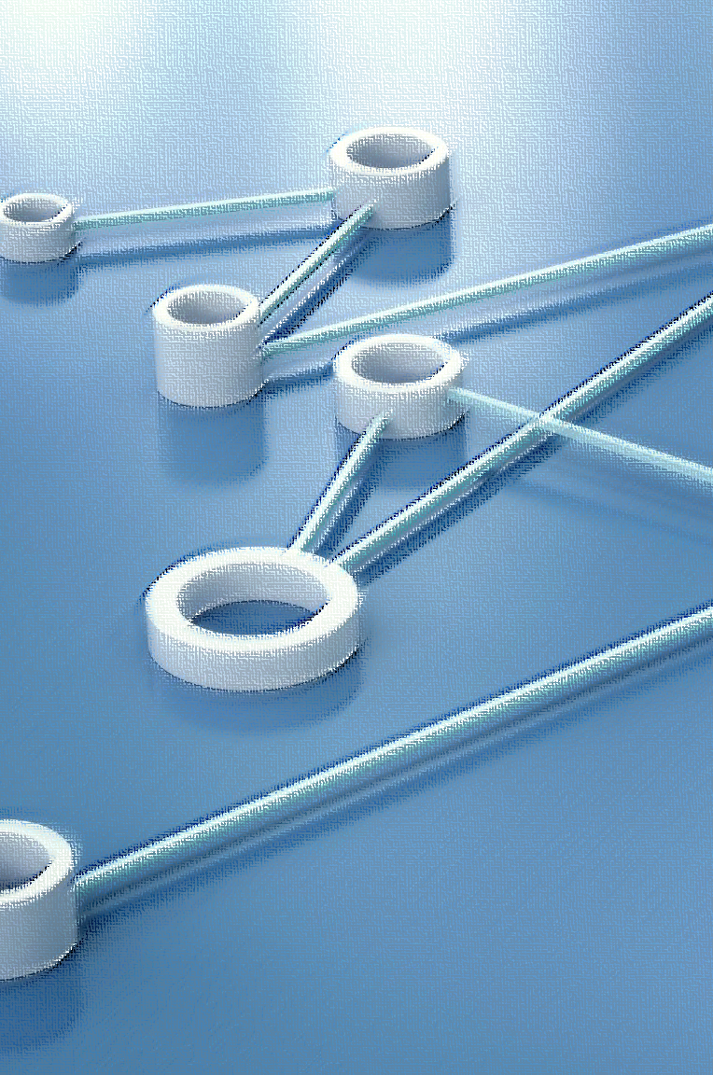
Node C - Object Manipulation
Node C handles the manipulation and placement of objects identified by Node B. It processes object coordinates and pick order from Node B and sets up a planning scene interface to ensure collision-free manipulation.

Slide 19

Pick-and-Place Cycle
Node C executes a pick-and-place cycle involving transforming coordinates, positioning the end effector, attaching and lifting objects, transporting them, and placing them using laser scan data for accurate table detection.

Slide 20
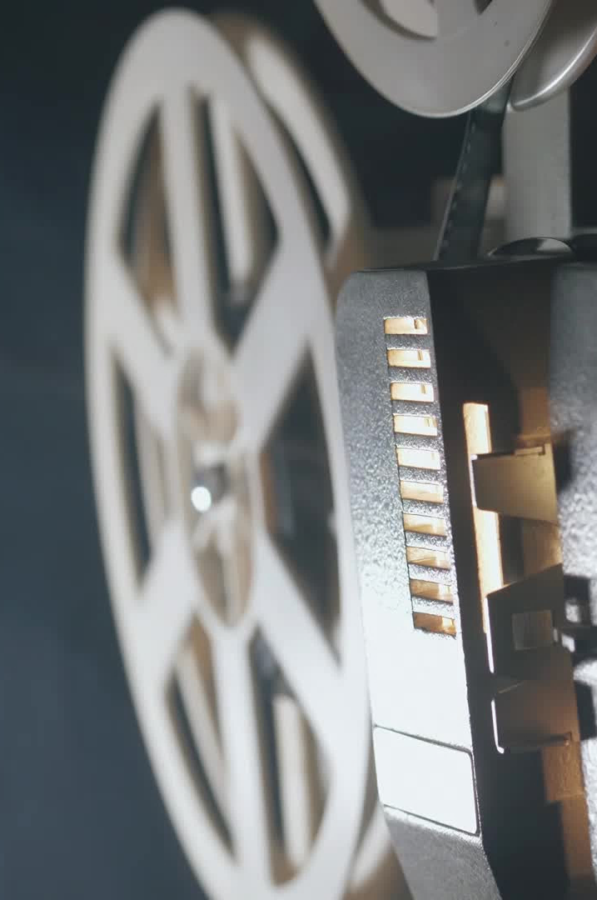
Laser Scan and Table Detection
The node uses laser scan data to detect and locate tables in the room, converting polar coordinates to Cartesian for accurate positioning.

Slide 21
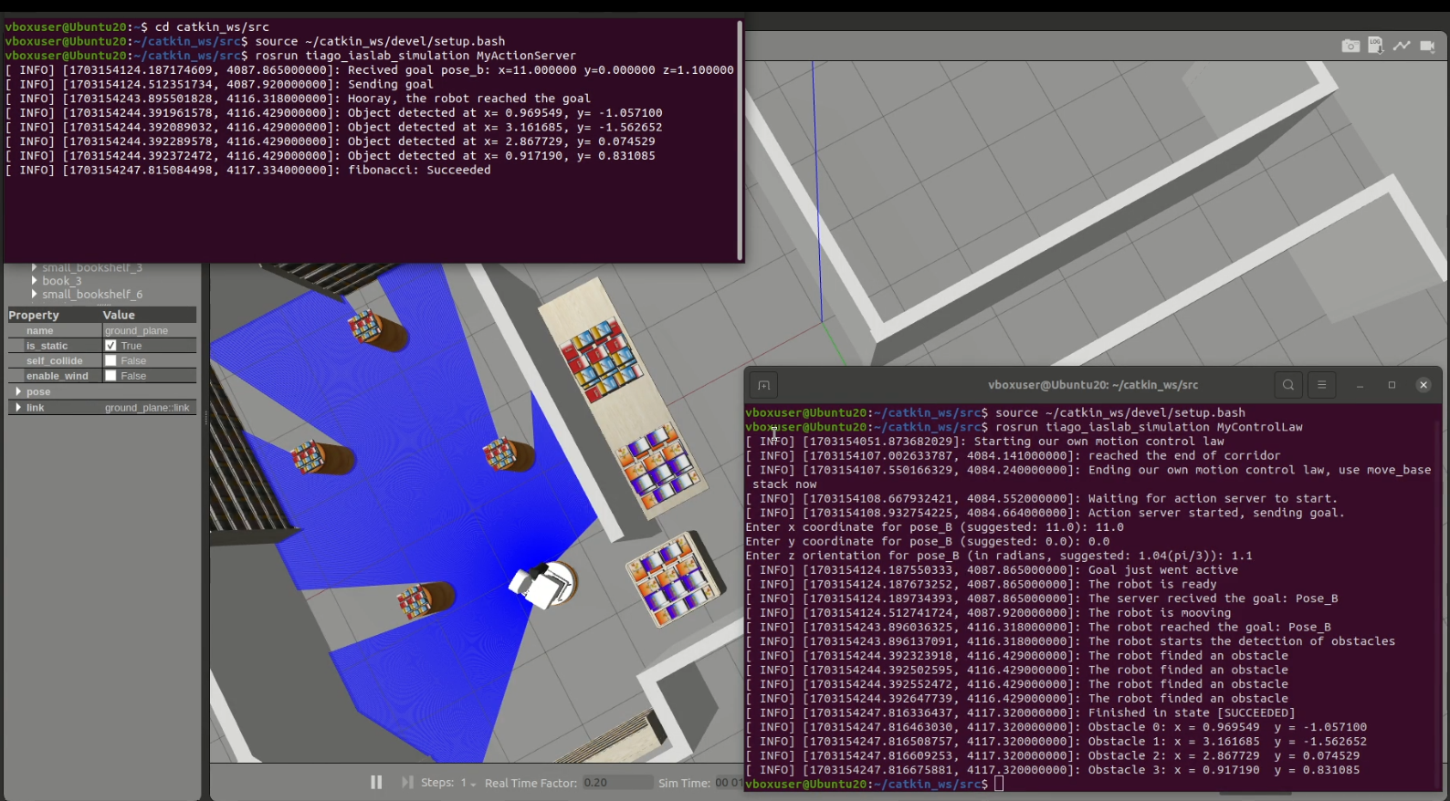
Communication between MyControlLaw and MyActionServer

Slide 22
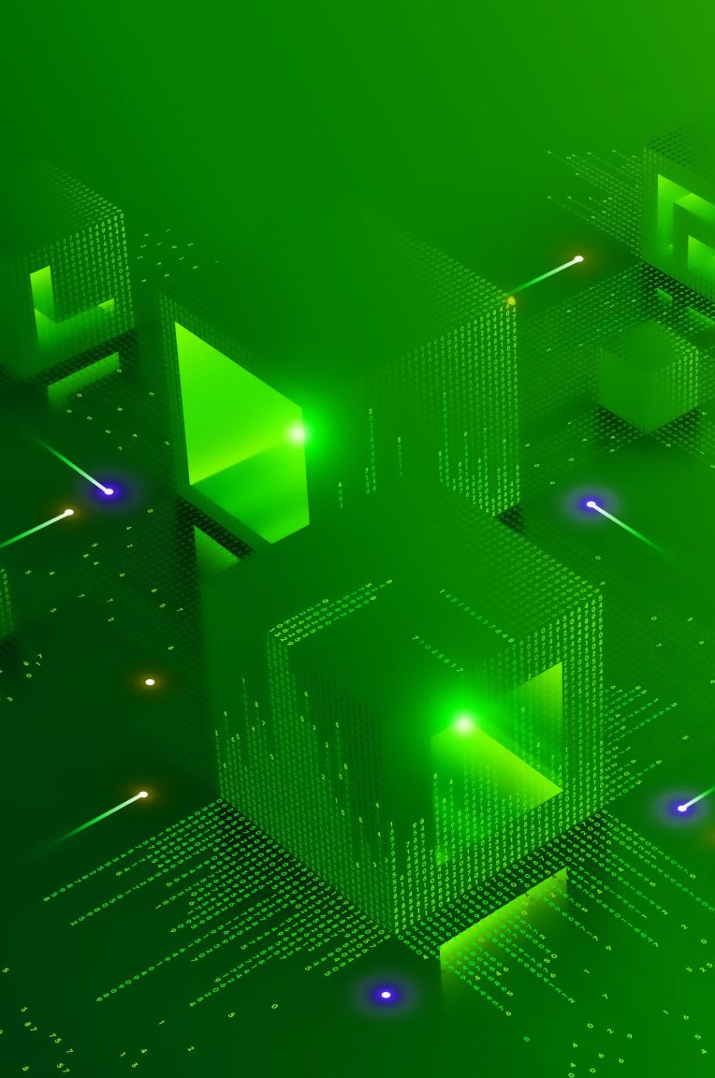
Achievements and Future Work
In conclusion, we successfully developed a modular, efficient system for robotic navigation, object detection, and manipulation. Future work could include enhancements to the object detection algorithms and broader applications of the system in different environments.

Slide 23

Questions
Thank you for your attention.

